Slide 1
Factors influencing channel growth on Twitch
Kaci Kus
7/19/20

Slide 2

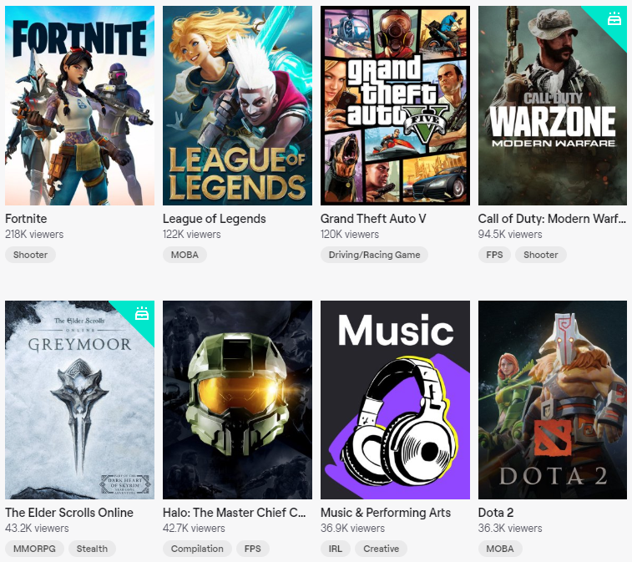
What is Twitch?
#1 Live Streaming Service
$5 billion net worth
As of March 2020:
15 million daily active users
1.44 million concurrent viewers on avg
41,100 Twitch Partners (+$2.50/subscriber)
Highest peak concurrent Twitch viewers: 533,000
Highest followed channel, with 7.8 million followers
If 1% of that person’s followers are subscribers…
= conservative estimate of $195,000/month

Slide 3


Why should we care?
Money!
It’s important to know how to maximize your viewers to maximize your money!
Top streamers can earn $1,000’s of dollars an hour from ad revenue
The number of viewers and followers DIRECTLY impacts a streamer’s bottom line

Slide 4


Executive Summary:
Time of day is the most important factor to:
Gain the most followers
Attract the most viewers
Increase followers gained 5% per hour by streaming between 6:00 pm and 6:00 am

Slide 5
Research Questions
“Time is money”
Do channels tend to gain more followers on weekends or weekdays?
Is there a correlation between longer stream times and the number of views?
H₀ : There is no difference between weekends and weekdays for the number of followers gained
H₀ : Longer stream times do not correlate with higher number of views

Slide 6
Data: Followers and Recent Broadcast History
Make API requests to get data directly from Twitch
<100,000 followers
English speaking
Any game
11 Channels (streamers)
Past 2 months of broadcasting
Followers
8,400 - 67, 700
Date and time they followed
Duration of broadcast
Date and time
# of viewers

Slide 7
Question 1
Do channels gain more followers on weekends or weekdays?

Slide 8
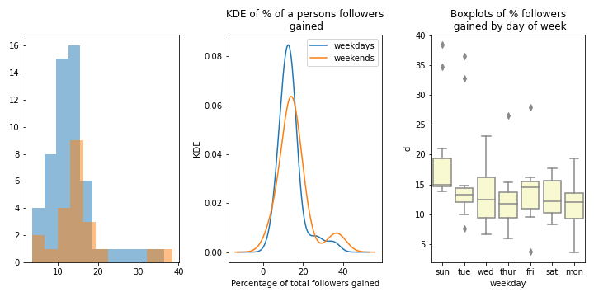
Q1: Do channels gain more followers on weekends or weekdays?
Total followers across 11 channels: 439,357
Hypothesis: There is no difference between day of the week and number of followers gained
weekday
weekend
No significant difference between the percentage of a channels following gained on weekdays vs weekends
Kruskal-Wallis test: p > 0.05
% of total followers gained
Sunday is the only day that gains a higher proportion of followers than other days of the week.
Does time of day matter?
% of total following gained
Sun Mon Tue Wed Thur Fri Sat
Notes:
Sunday is statistically different than all days of the week except for thursday

Slide 9
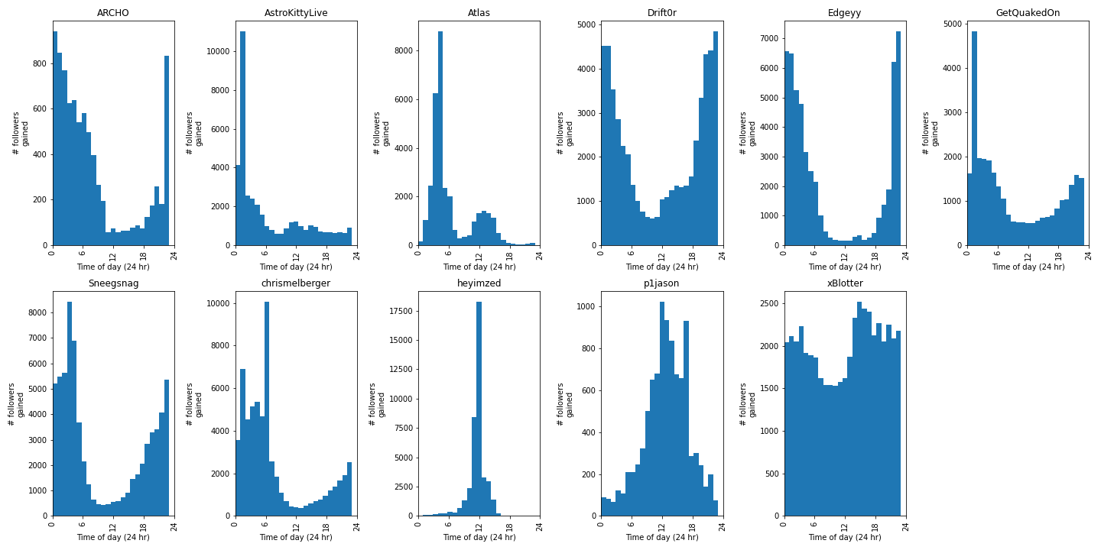
Followers gained by time of day (hour)

Slide 10
Channels tend to gain more followers in the evening
General trend
Significantly more followers are gained in the evening
Before 6:00 am
After 6:00 pm
Number of followers gained
12 am
6 am
12 pm
6 pm
12 am
Time of day

Slide 11
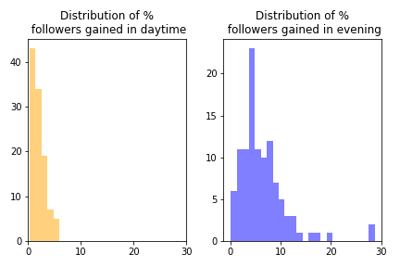
Compare evening vs daytime
Channels gain <5% of their following during daytime hours
6:00 am - 6:00 pm
6:00 pm - 6:00 am
By streaming in the evening compared to daytime, channels are likely to increase the number of followers they gain anywhere between
3.4% and 5.3% per hour
Frequency
% of followers gained
daytime
% of followers gained
evening

Slide 12
Question 2
Does duration of a stream affect the number of viewers?

Slide 13
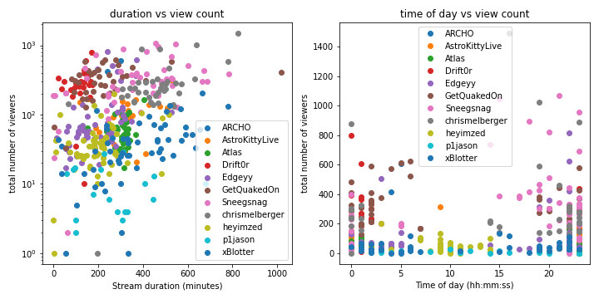
Q2: Does the duration of a broadcast matter?
Hypothesis: streaming for a longer period of time might result in more viewers
Weak correlation between number of viewers and duration of stream.
Correlation coefficient = 0.27
However, time of day does seem to have some correlation with a higher number of views!
Notes:
Calculate correlation coefficient

Slide 14


Summary:
Time of day is the most important factor to:
Gain the most followers
Attract the most viewers
Sunday may be optimal day of the week, but no significant difference between other days
Increase followers gained 5% per hour by streaming between 6:00 pm and 6:00 am
Longer streams ≠ more viewers

Slide 15
Future work
A/B test
Randomly select 240 channels
Channels must be equal size
Channels must play the same game
Limit when they can stream to 1 hour blocks beginning at the same time every day
10 channels for each hour of the day
Run experiment for 2 weeks
 | Time slot | Followers gained week 1 | Followers gained week 2
Channel 1 | 3 am - 4 am | 15 | 16
Channel 2 | 12 pm - 1 pm | 10 | 15
Channel 3 | 7 pm - 8 pm | 20 | 22
Hypothesis
→ There will be no significant difference in the number of followers gained by allotted time of day
Notes:
Make the a/b test into a few slides
What would success look like?

Slide 16
Questions?

